Slide 1

Analyzing trends in the video Gaming Industry
By: chima okwuoha

Slide 2
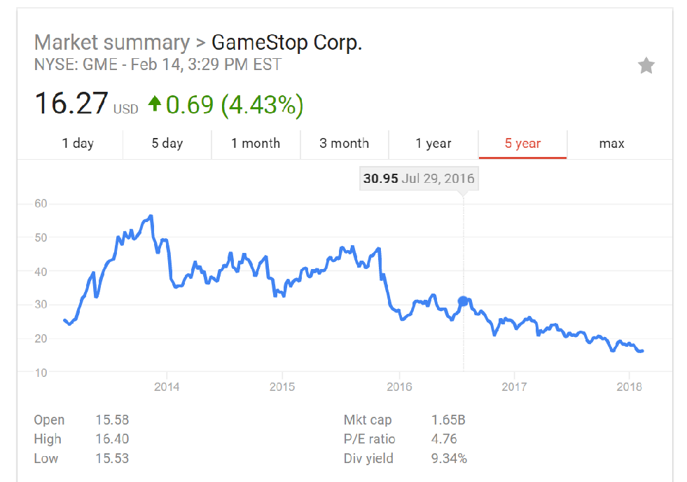
Within the last decade we have seen major shifts in the way game are dispensed to consumers. While companies like Game stop are on the decline,[1] online stores like steam have dominated the mainstream gaming culture.

Slide 3
Motivation
This shift has resulted in an increased amount of major game developers creating more Indie games[2].
Carrying a digital copy of a gaming a online store is less risky than selling Hard copies
With this new shift, there is need to understand what kind of predictors set a game up for failure or success in the new gaming market.

Slide 4
Methods
This project seeks to generate data via web scrapping two major gaming websites.
Steam store
-Analyzing tags on trending games to see what genres or combination of genres sell the most
Gamespot reviews
-Analyzing descriptive words to determine what clients value in video games

Slide 5
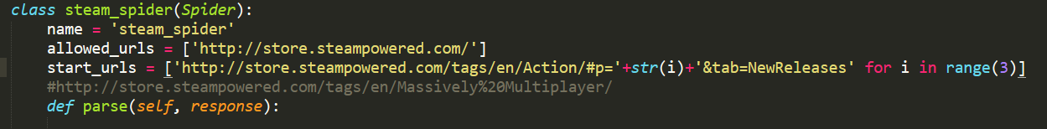
Persistent Problem scaping steam
While scrapping steam we realized that steam manages to prevent mass scrapping by redirecting URL requests

Slide 6
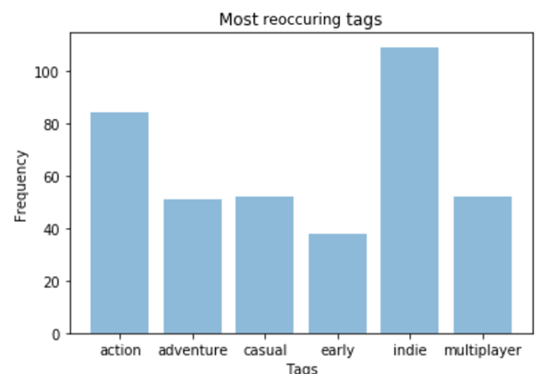
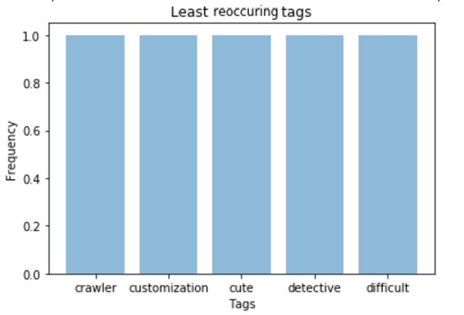
Steam store –General overview

Slide 7
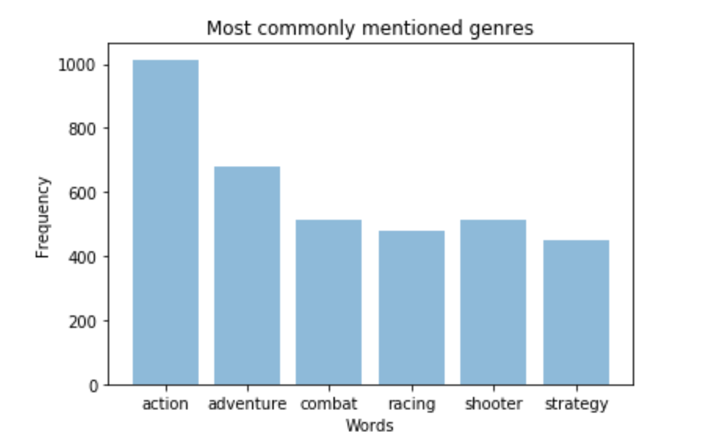
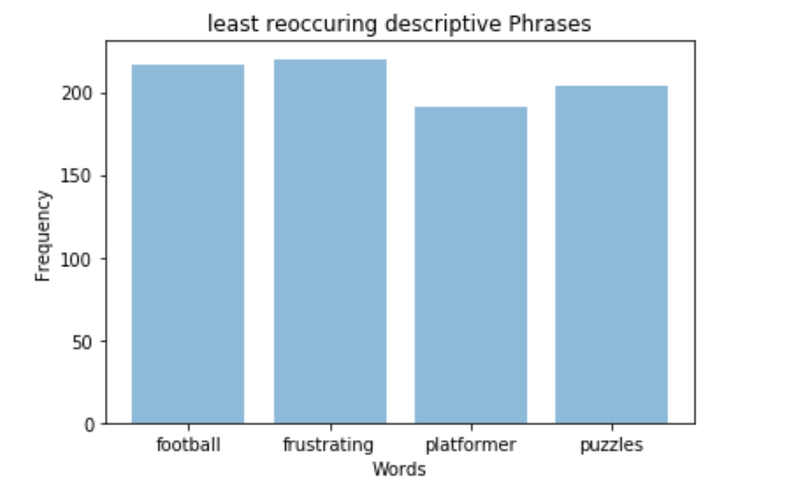
Word Frequencies

Slide 8
Discussion
~Comparing results we see that adventure, r.p.g., action games are the most widely sold content.
~ Puzzles, Mystery, Detective and Racing games appears to be on the lower end.
Limitations of this study
~This information is more biased towards recent trends in marketing.
~Just because a genre is larger doesn’t necessarily mean it’s a good idea to enter that market. It could mean the exact opposite
~relies on human interpreter to isolate words of interest

Slide 9
Future Aspirations
~ Attempt to individualize the trends for different platforms
~ Look for profitable combinations of genres

Slide 10
Resources
Articles
[1]:https://www.theverge.com/2017/3/25/15059380/gamestop-store-closings-2017-digital-sales-collectibles-business
[2]: https://venturebeat.com/2017/09/07/why-triple-a-devs-are-going-indie-and-why-indie-arent-going-triple-a/
[3] steam.powered.com
[4].gamespot.com

